Slide 1
Digital Electronics and Computer Architecture
A project on Counter up till hundred using Arduino and LCD screen
Madhur by : Madhur Nagrath(19csu169)

Slide 2
Learning Objectives
Connecting LCD and push button to Arduino board.
Writing a programme to increase counter when push button is pushed.

Slide 3
Pre-Requisites
Basic knowledge of Electronics and its components.
Basic knowledge of programming languages like C++ or Arduino coding.

Slide 4
Materials Required
Male to male wire
Male to female wire
Female to female wire
16X2 LCD screen
200 ohm resistor
LED’s
Arduino
Push Button

Slide 5
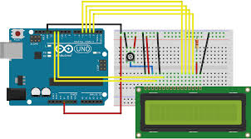
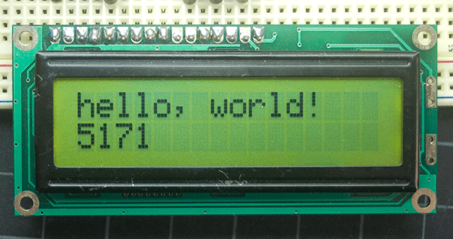
About Crystal library
This library allows an Arduino board to control LiquidCrystal displays (LCDs) based on the Hitachi HD44780 (or a compatible) chipset, which is found on most text-based LCDs.

Slide 6
Procedure
Step1 : Build a simple Arduino LCD counter using simple components like LCD.
Step2 : Connect an LCD to Arduino board.
Step3: Write a program in the Arduino IDE.
Step4: Write the code for void loop.
Step5: Write a simple if statement to check whether the pushbutton is pressed or not.(Optional step).
Step6: Compile and upload the program.
Step7: Modify the program to set a counter by adding a while loop(when Ush button is included)
Step8: Again compile and upload the program.

Slide 7
Code Explanation (Without Button)
#include <LiquidCrystal.h> // include the library code
LiquidCrystal lcd(12, 11, 5, 4, 3, 2); // initialize the library with the numbers of the interface pins
void setup() {
lcd.begin(16, 2); // set up the LCD's number of columns and rows;
}
for(int i=1;i<101;i++){
lcd.print(i); // Print numbers on the LCD.
delay(750);
}
}

Slide 8
void loop() {
lcd.setCursor(0, 1); // set the cursor to column 0, line 1
lcd.print(millis() / 1000); // print the number of seconds since reset
}

Slide 9
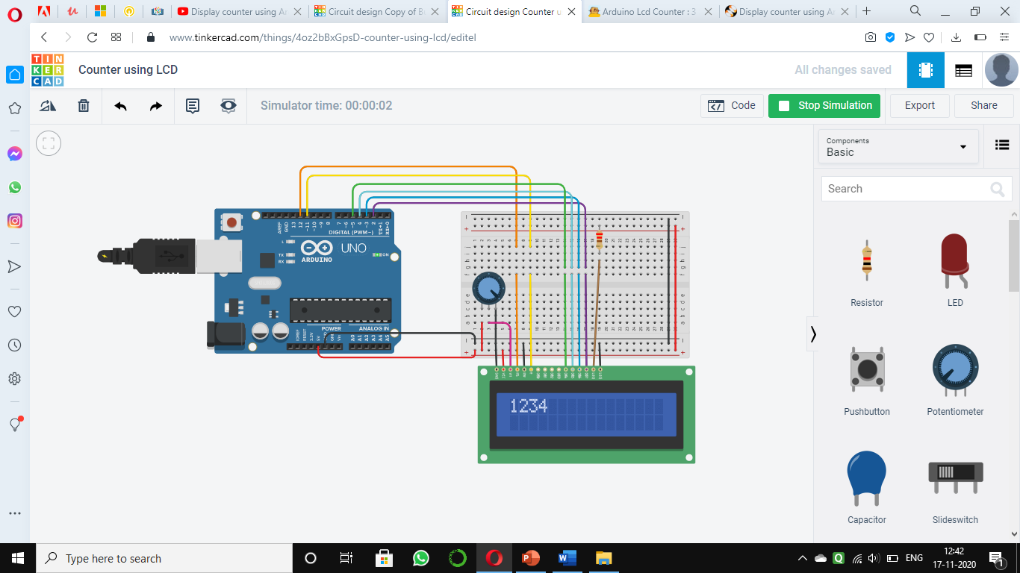

Slide 10


Slide 11
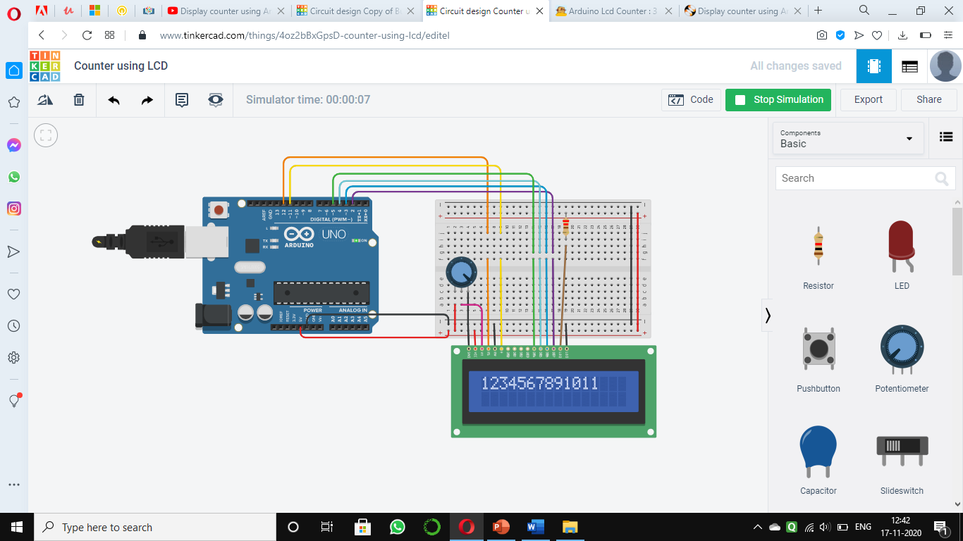

Slide 12
Procedure with Push Button
Connect an LCD and a Push button to Arduino board.
Use the same circuit created earlier using Arduino and LCD
Add a pushbutton and make a simple counter
Learn the connection circuit details
See the live setup of the connection
Write a program in the Arduino IDE write the code for void loop write a simple if statement to check whether the pushbutton is pressed or not
Compile and upload the program
See that pushbutton is working successfully
Write a while statement Again compile and upload the program Output: count is increased whenever the button is pressed

Slide 13
With Push Button
#include <LiquidCrystal.h> // include the library code
int push=7; (initialize if we use button otherwise not)
LiquidCrystal lcd(12, 11, 5, 4, 3, 2); // initialize the library with the numbers of the interface pins
void setup() {
lcd.begin(16, 2); // set up the LCD's number of columns and rows;
pinMode(push,INPUT)
.
for(int i=1;i<101;i++){
lcd.print(i); // Print numbers on the LCD.
delay(750);
}
}

Slide 14
Void loop(){
If DigitalRead(push)==HIGH{
LCD.setCursor(0,0)
Lcd.print(i)
while (digitalRead(push==High)
}
}

Slide 15
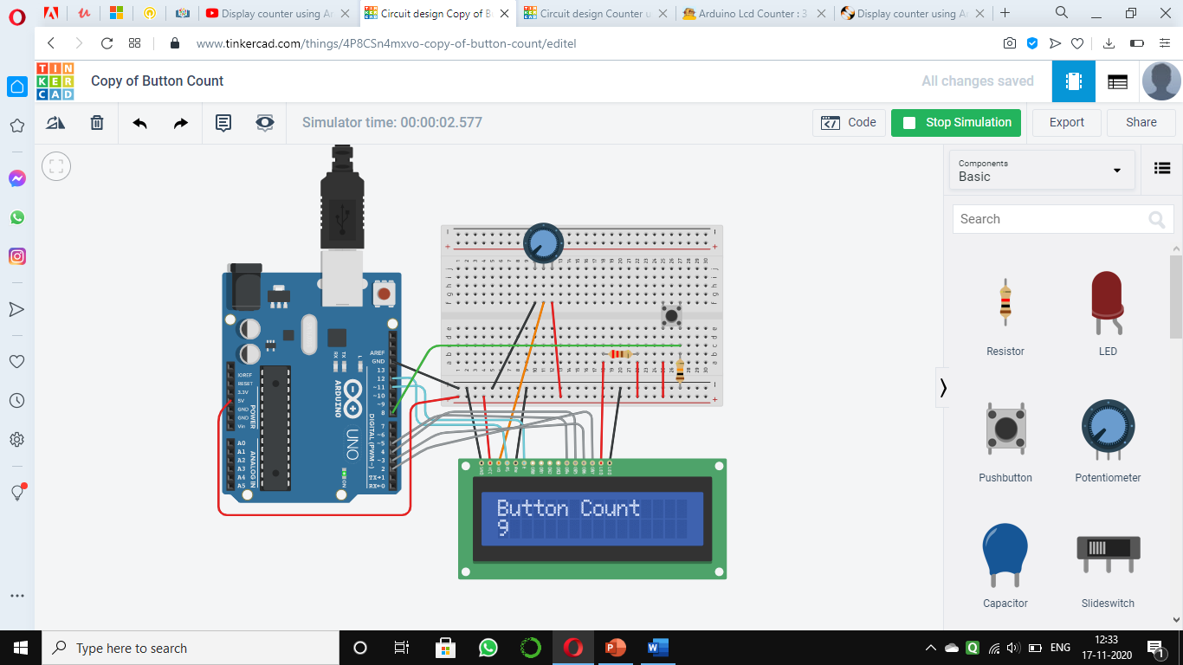

Slide 16


Slide 17
Result
We were able to build a counter up till 100 using Arduino and LCD screen by using/not using a Push Button.

